Slide 1
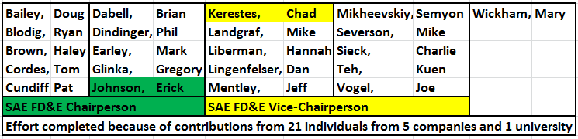
Phase II
Total Fatigue Life
(Crack Initiation + Crack Propagation)
SAE FD&E Current Effort
30 October 2012 at Peoria, IL

Slide 2
Effort Definition
Steel procurement, prototype test specimen design/fabrication, prototype test and prototype test result.
Steel pedigree (material characterization) definition/documentation.
Accurate loading definition
Test component geometry for stress/strain (FEM and other) analysis.
Total fatigue life predictions (crack initiation + crack propagation and other).
The next (crucial) step for discerning the transition from crack initiation to crack propagation.
Test Matrix and Future Work (committed to and not committed to).

Slide 3
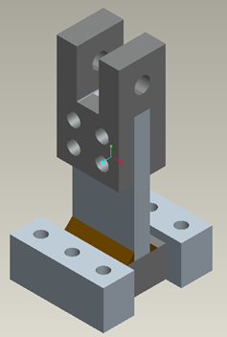

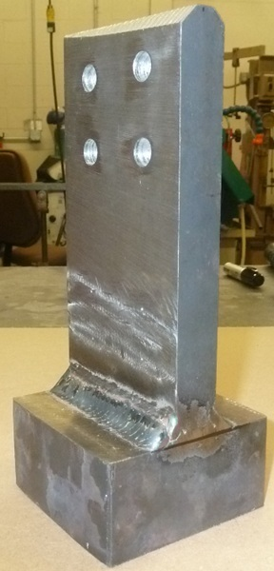
Load Carrying Weld
Specimen Configuration and Test Fixture/FEM Boundary Conditions
See Next Slide

Slide 4
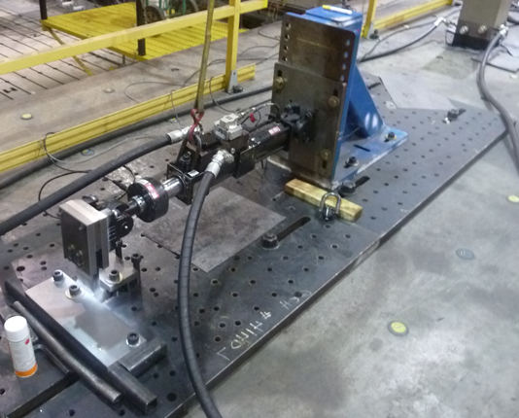
Specimen in Test Rig
See Next Slide

Slide 5
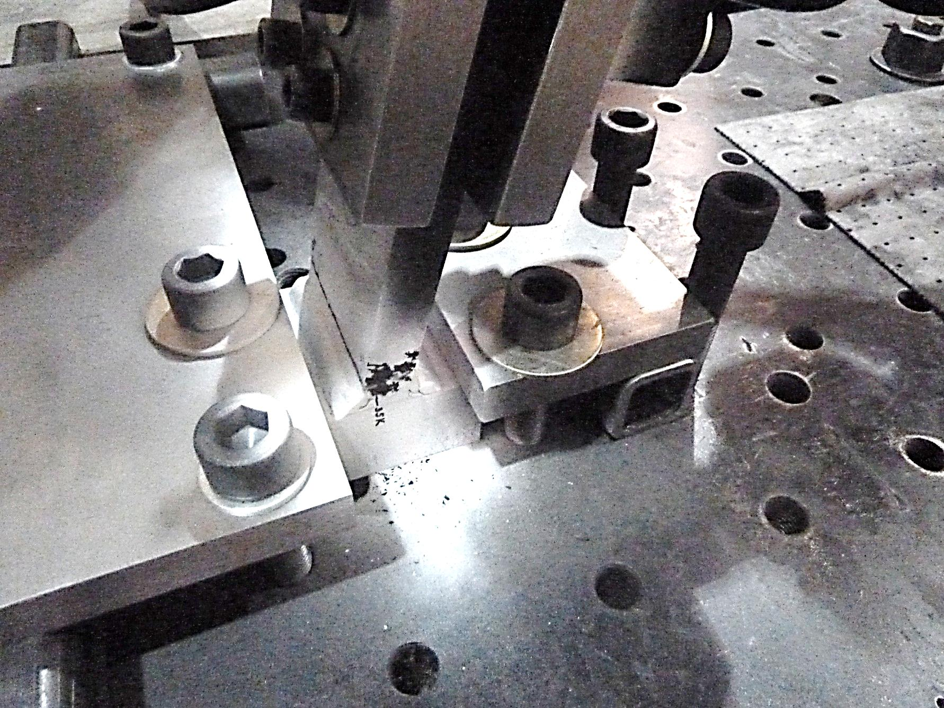
Specimen Crack After Inability To Carry Load In Test Rig
See Next Slide

Slide 6
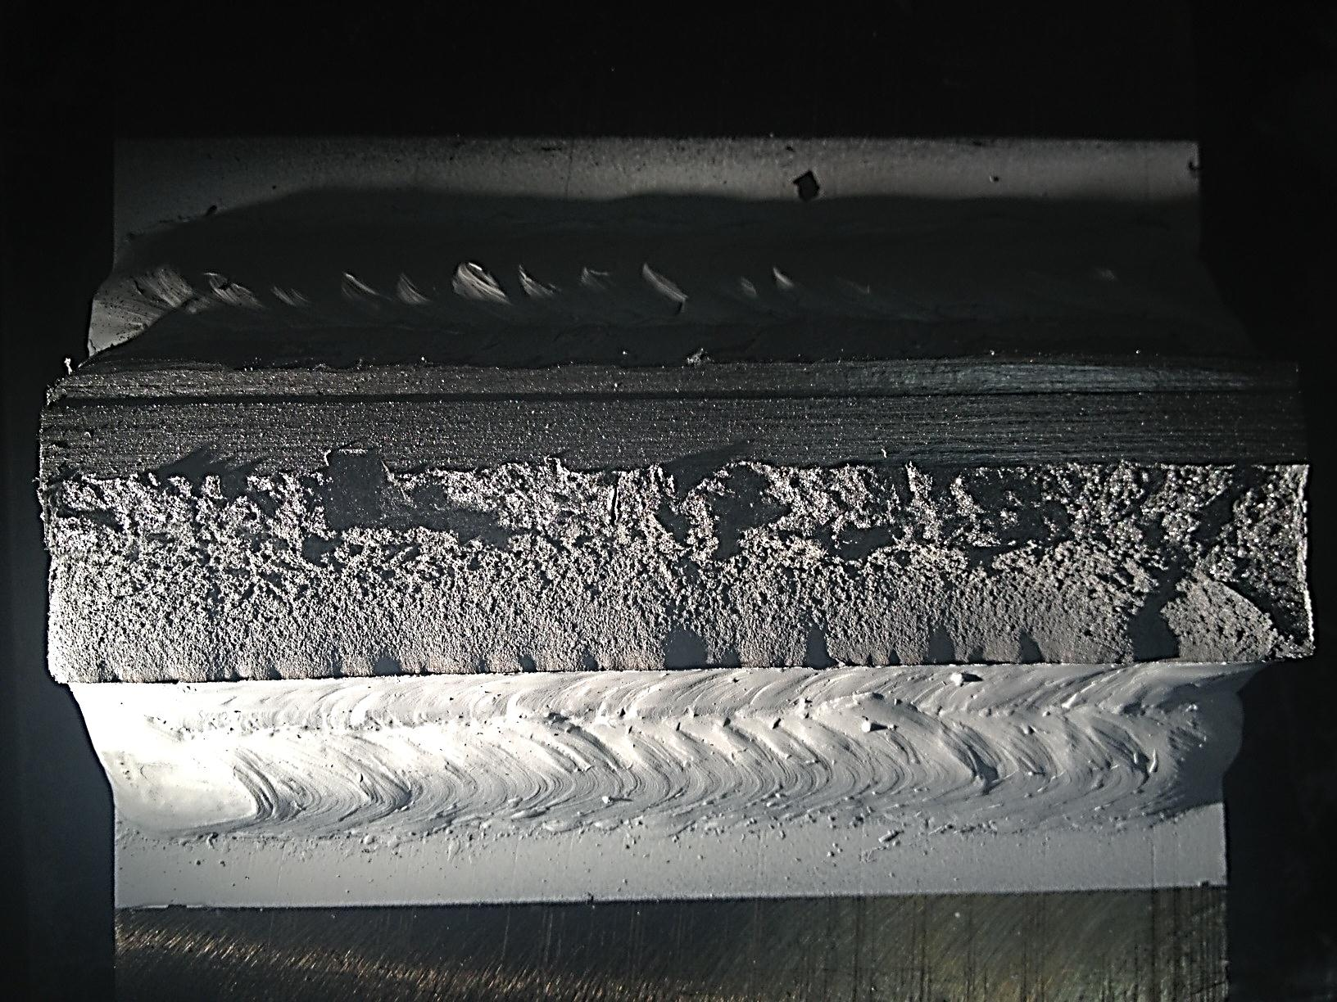
Specimen Crack Fracture Surface
Total Prototype Test Fatigue Life (Crack Initiation + Crack Propagation) = 36,895 Cycles

Slide 7
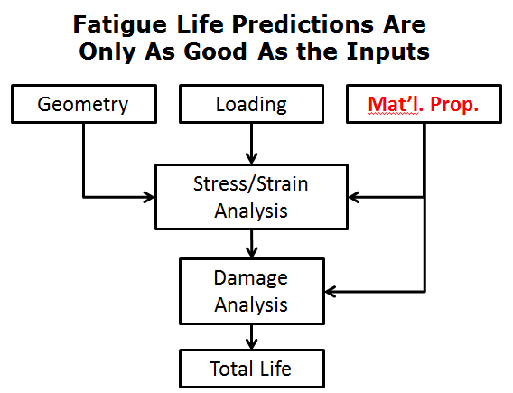
Effort Definition
Steel procurement, prototype test specimen design/fabrication, prototype test and prototype test result.
Steel pedigree (material characterization) definition/documentation.
Accurate loading definition
Test component geometry for stress/strain (FEM and other) analysis.
Total fatigue life predictions (crack initiation + crack propagation and other).
The next (crucial) step for discerning the transition from crack initiation to crack propagation.
Test Matrix and Future Work (committed to and not committed to).

Slide 8
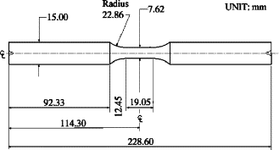
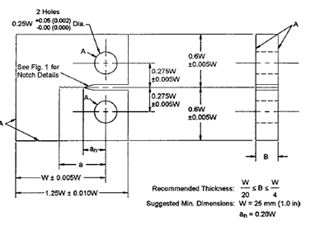

Exact – Same Steel Pedigree
(Material Characterization) Definition/Documentation
Purchased “Enough” 4 A36 20ft HR bars
Microstructure, Chemistry & Hardness
Sample

Slide 9
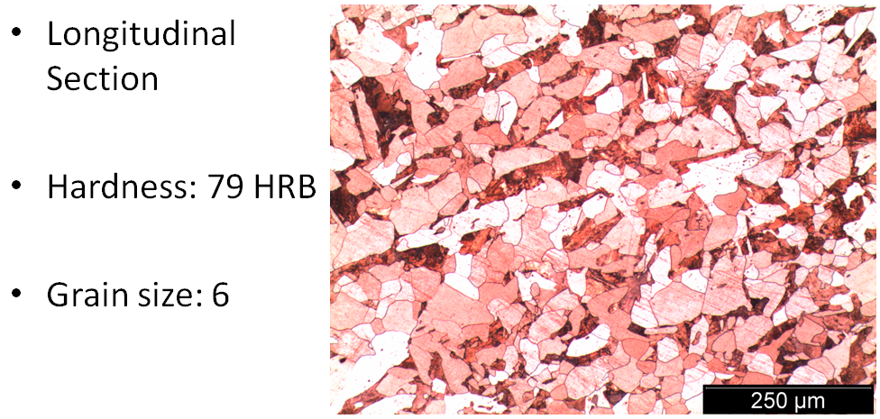
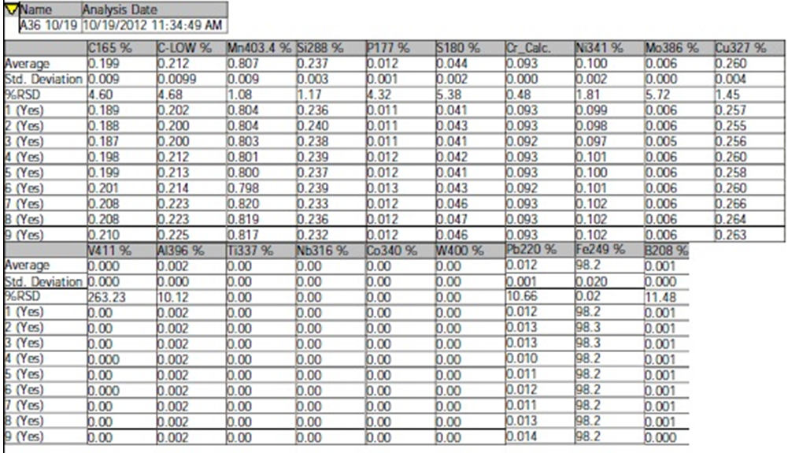
Steel Microstructure, Hardness, Grain Size and Chemistry

Slide 10
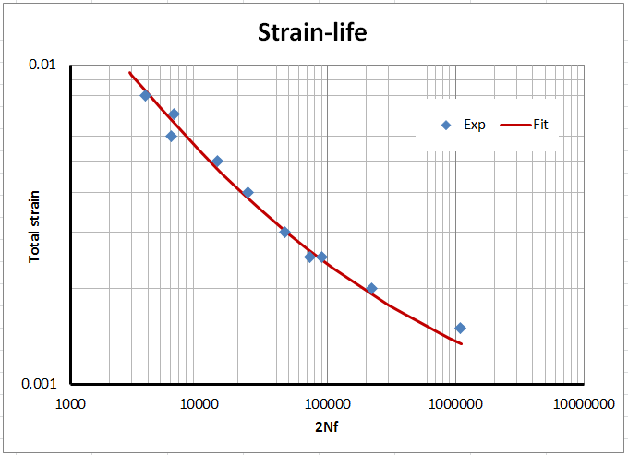
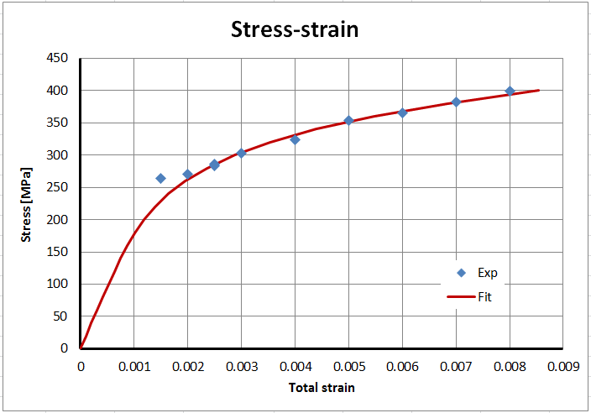
Steel Local Strain Low Cycle Crack Initiation Material Characterization

Slide 11
Steel Local Strain Low Cycle Crack Initiation Material Characterization
Assumes the welding residual tension stress is equal to the steel’s proportional limit (for Ni analysis only): 1200ue

Slide 12
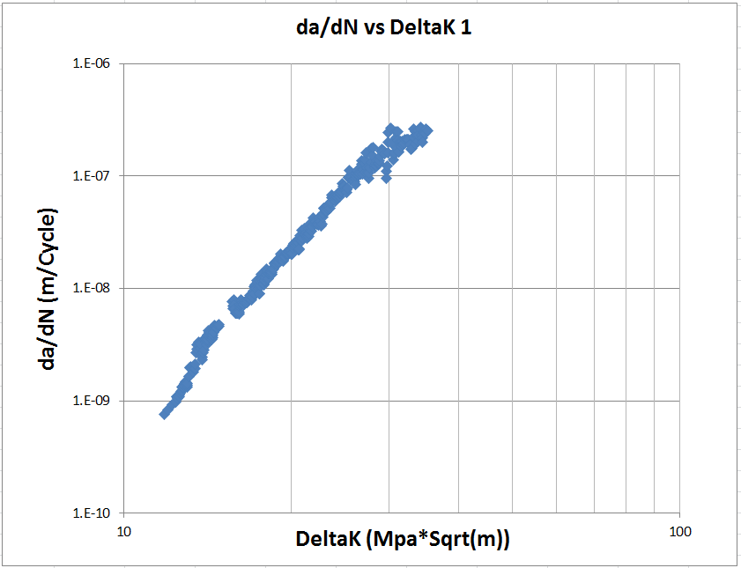
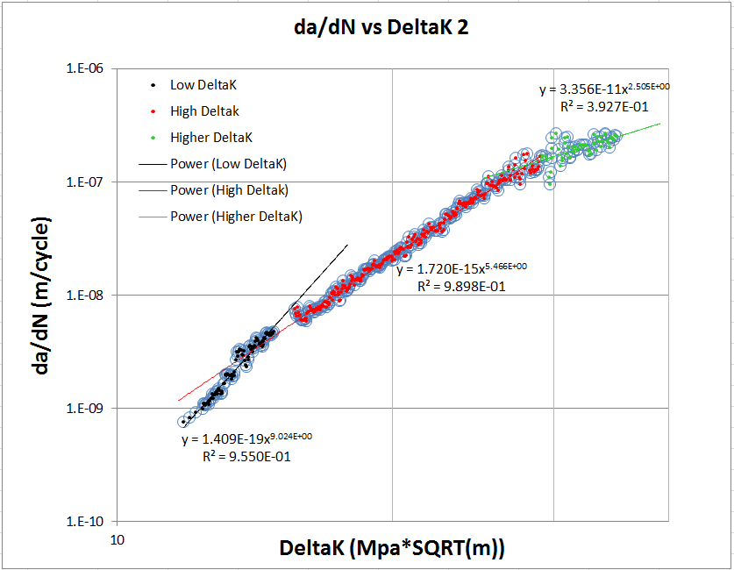
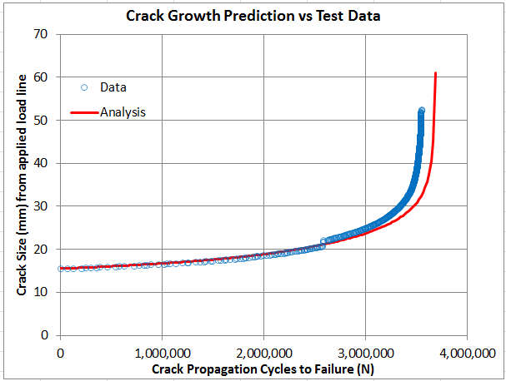
Steel Crack Propagation Material Characterization

Slide 13
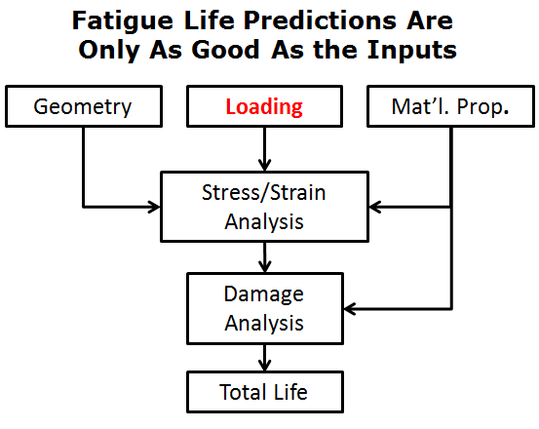
Effort Definition
Steel procurement, prototype test specimen design/fabrication, prototype test and prototype test result.
Steel pedigree (material characterization) definition/documentation.
Accurate loading definition
Test component geometry for stress/strain (FEM and other) analysis.
Total fatigue life predictions (crack initiation + crack propagation and other).
The next (crucial) step for discerning the transition from crack initiation to crack propagation.
Test Matrix and Future Work (committed to and not committed to).

Slide 14
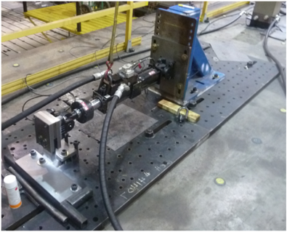
Accurate Loading Definition
24 KN to 2.4 KN
R=0.1

Slide 15
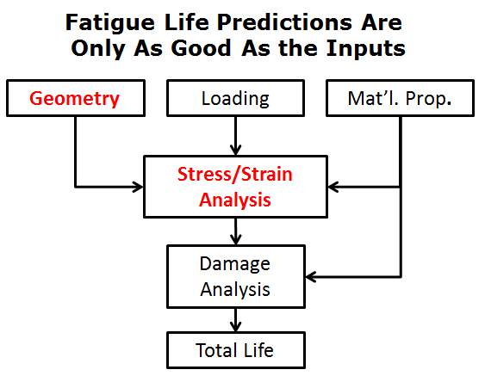
Effort Definition
Steel procurement, prototype test specimen design/fabrication, prototype test and prototype test result.
Steel pedigree (material characterization) definition/documentation.
Accurate loading definition
Test component geometry for stress/strain (FEM and other) analysis.
Total fatigue life predictions (crack initiation + crack propagation and other).
The next (crucial) step for discerning the transition from crack initiation to crack propagation.
Test Matrix and Future Work (committed to and not committed to).

Slide 16
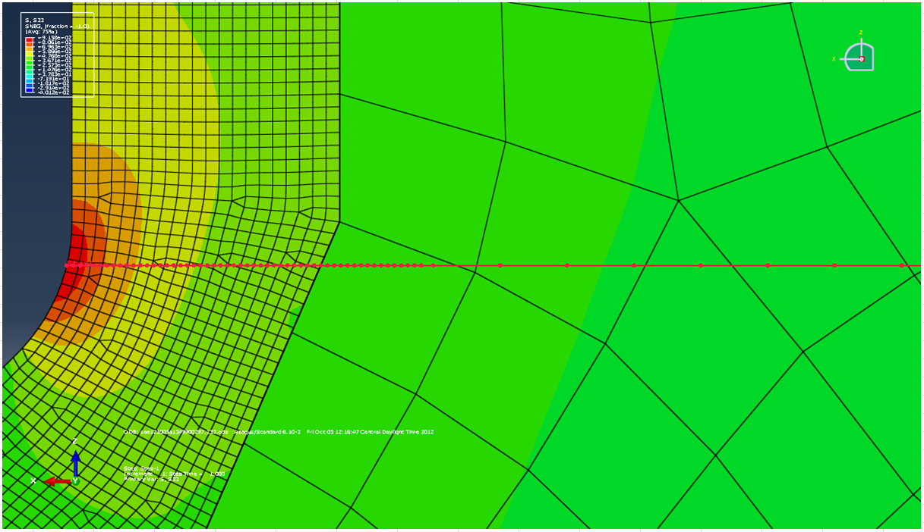
Component Stress/Strain Distribution Path Across Critical Section

Slide 17
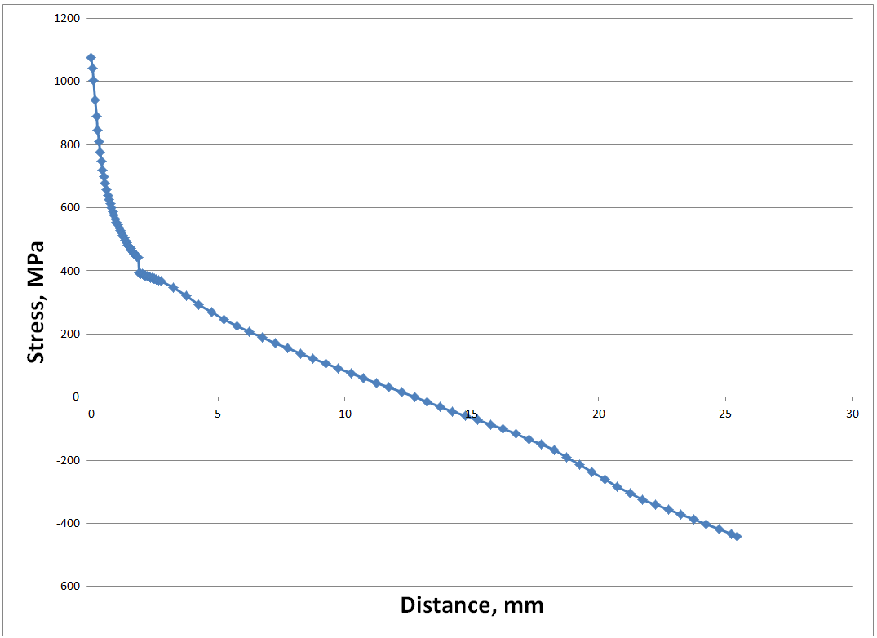
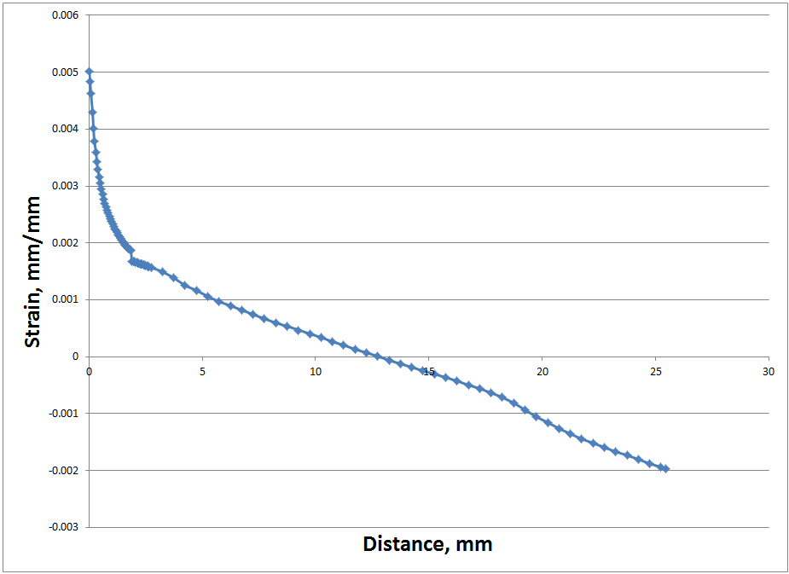
Component Stress/Strain Distribution Path At Weld Toe Critical Section
FEM Stress
FEM Strain

Slide 18
Component BS 5400 or BS7608 Stress Analysis
(by an expert with decades of experience)
Analysis is simple with BS 5400 or BS7608 methods. Input is simply nominal stress range and weld class with a modifier for plate thickness. This is a fillet weld with the stress perpendicular to the toe so I would call it class F. Equation for class F is S=11995(N)^(-0.333) Stress range is = delta m*C/I = .9*24000*225*12.7/(101.6*25.4^3/12)=445 MPa. (This is a bit higher than the 400 I get by extrapolating the linear section of Eric’s plot from FEA.) Since the plate is 1 inch and curves are based on 0.5 strength is modified by (0.5/1)^.25 = 0.84 (This was also proposed by Fred Lawrence.) The intercept of the SN curve would be 11995*0.84 = 10086. Since this is a design curve, I would increase strength by about 10% for this lab test. So 10086*1.1= 11095 and N = 15,500 cycles.
Use some judgment in applying this number. Since the R ratio is high, life might be expected to be a bit less but since the calculated elastic stress is above the material strength, there will be yielding so that the actual stress range will likely not be as high as predicted. Also, curves were developed with axial specimens tested to failure and this is bending this piece should last a bit longer. I would expect life to be between 15,000 and 60,000 cycles to get to the point where it will not carry the load.

Slide 19
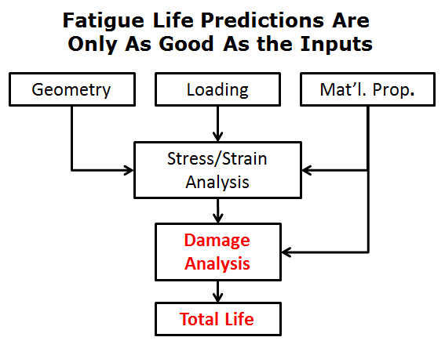
Effort Definition
Steel procurement, prototype test specimen design/fabrication, prototype test and prototype test result.
Steel pedigree (material characterization) definition/documentation.
Accurate loading definition
Test component geometry for stress/strain (FEM and other) analysis.
Total fatigue life predictions (crack initiation + crack propagation and other).
The next (crucial) step for discerning the transition from crack initiation to crack propagation.
Test Matrix and Future Work (committed to and not committed to).

Slide 20
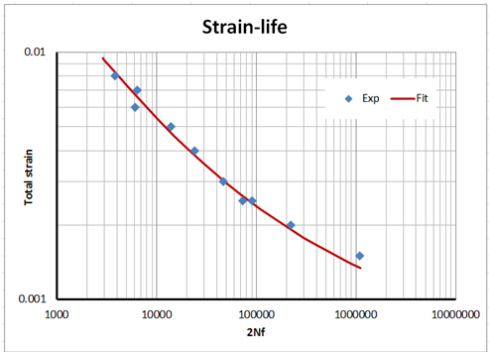


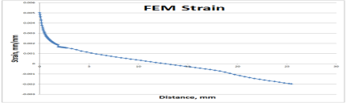
Local Strain Low Cycle Crack Initiation Fatigue Analysis
Appropriately Meshed Mesh of CAD Geometry
24 KN to 2.4 KN R=0.1
Crack Initiation Material Characterization
Geometry
Loading
Mat’l. Prop.
Stress/Strain Analysis
Crack Initiation Analysis Program
Crack Initiation Life
13,070Cycles

Slide 21
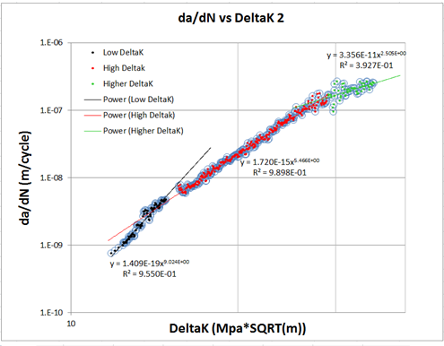
Linear Elastic Fracture Mechanics Crack Propagation Fatigue Analysis
Appropriately Meshed CAD Geometry
24 KN to 2.4 KN R=0.1
Crack Propagation Material Characterization
Geometry
Loading
Mat’l. Prop.
Stress Distribution
Crack Propagation Analysis Program
Crack Propagation Life
45,190 Cycles

Slide 22
Total Life
Geometry
Loading
Mat’l. Prop.
Stress/Strain Analysis
Damage Analysis
Total Life
Total Life = Crack Initiation + Crack Propagation
= 13,070 Cycles (CI) + 45,190 Cycles (CP-SE) + 0 Cycles (CP-EC) = 58,260 Cycles
Predicted life/Test Life (of 1 Hand Welded Prototype Sample)
=58,260 Cycles/36,895 Cycles = 1.6

Slide 23
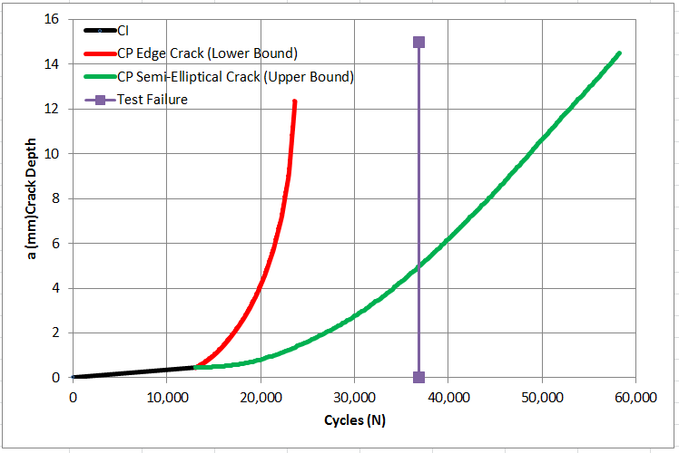

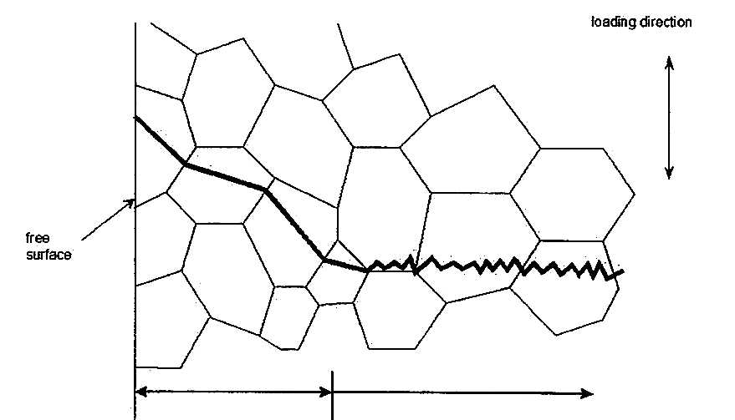

Predict the Upper and Lower Total Fatigue Life Bounds (Using “Principal” ue for CI)
Loading Direction
Free Surface
CI
CP

Slide 24
Component BS 5400 or BS7608 Stress Analysis
(by an expert with decades of experience)
Analysis is simple with BS 5400 or BS7608 methods. Input is simply nominal stress range and weld class with a modifier for plate thickness. This is a fillet weld with the stress perpendicular to the toe so I would call it class F. Equation for class F is S=11995(N)^(-0.333) Stress range is = delta m*C/I = .9*24000*225*12.7/(101.6*25.4^3/12)=445 MPa. (This is a bit higher than the 400 I get by extrapolating the linear section of Eric’s plot from FEA.) Since the plate is 1 inch and curves are based on 0.5 strength is modified by (0.5/1)^.25 = 0.84 (This was also proposed by Fred Lawrence.) The intercept of the SN curve would be 11995*0.84 = 10086. Since this is a design curve, I would increase strength by about 10% for this lab test. So 10086*1.1= 11095 and N = 15,500 cycles.
Use some judgment in applying this number. Since the R ratio is high, life might be expected to be a bit less but since the calculated elastic stress is above the material strength, there will be yielding so that the actual stress range will likely not be as high as predicted. Also, curves were developed with axial specimens tested to failure and this is bending this piece should last a bit longer. I would expect life to be between 15,000 and 60,000 cycles to get to the point where it will not carry the load.

Slide 25
Effort Definition
Steel procurement, prototype test specimen design/fabrication, prototype test and prototype test result.
Steel pedigree (material characterization) definition/documentation.
Accurate loading definition
Test component geometry for stress/strain (FEM and other) analysis.
Total fatigue life predictions (crack initiation + crack propagation and other).
The next (crucial) step for discerning the transition from crack initiation to crack propagation.
Test Matrix and Future Work (committed to and not committed to).

Slide 26
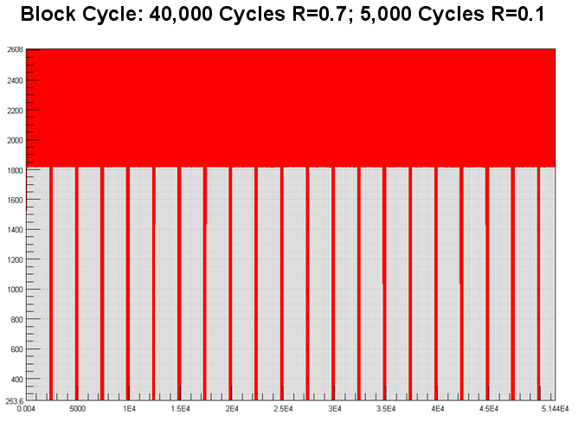
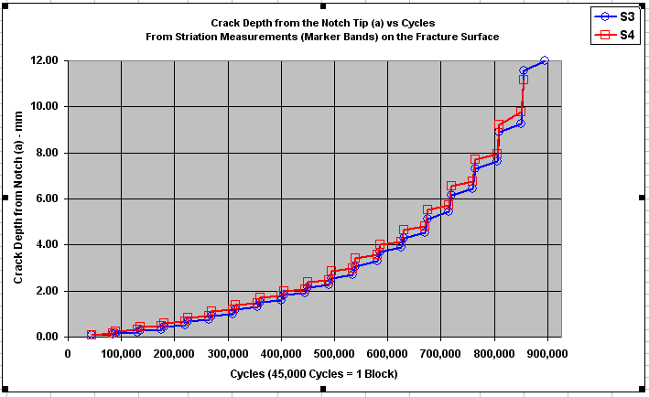
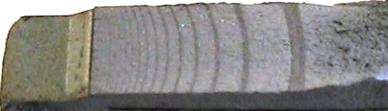
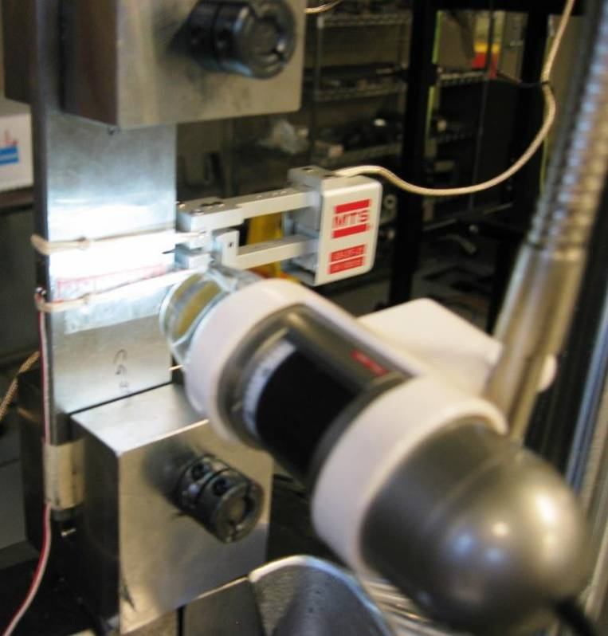
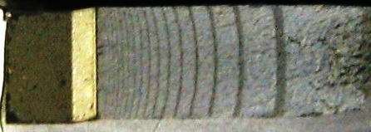
Accurate Scanning Electron Microscope (SEM) Crack Growth Measurements
1.467 in
R = 0.5
0.312 in holes
0.200 in
a
a
To be evaluated by a second robotic welded prototype test

Slide 27
Effort Definition
Steel procurement, prototype test specimen design/fabrication, prototype test and prototype test result.
Steel pedigree (material characterization) definition/documentation.
Accurate loading definition
Test component geometry for stress/strain (FEM and other) analysis.
Total fatigue life predictions (crack initiation + crack propagation and other).
The next (crucial) step for discerning the transition from crack initiation to crack propagation.
Test Matrix and Future Work (committed to and not committed to).

Slide 28
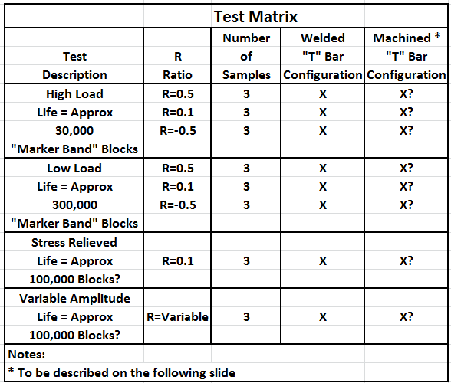
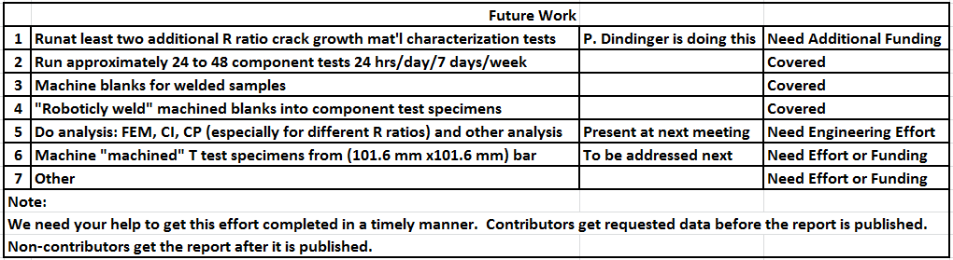
Test Matrix and Future Work
: Read marker band “striation patterns

Slide 29
Machined
Specimen Configuration and Test Fixture/FEM Boundary Conditions
Eliminate the weld entirely – machine the entire specimen from the 101.6 mm x 101.6 mm bar. Duplicate, by machining, the weld profile and weld toe radius as closely as possible so the sample is consistently made from the same material. Comparing the test results from these samples relative to the test results from the previously welded samples. This will confirm (or not) how sound an assumption it is to use the base material properties when analyzing welded structures.

